Slide 1
H1N1-Vaccine Uptake Prediction
Presented by : frankline kipkemboi

Slide 2
Project Overview
This project uses machine learning to predict whether an individual received the H1N1 vaccine using survey data from the National 2009 H1N1 Flu Survey.
The goal is to help public health authorities understand the factors that influence vaccine uptake and support targeted vaccination campaigns.

Slide 3
Problem Statement
Public health authorities need to increase vaccination uptake to reduce the spread of infectious diseases and protect the vulnerable population. However, many individuals choose not to receive vaccines due to differences in beliefs, health behaviours, risk perception and access to healthcare. Without understanding which groups are less likely to vaccinate, it is difficult for health organisations to design effective outreach and vaccination campaigns.

Slide 4
Business Understanding
KEY QUESTION FOR PREDICTING H1N1 VACCINE UPTAKE
Which factors influence whether an individual receives the H1N1 flu vaccine and can we accurately predict who is likely or unlikely to get vaccinated?
Which demographic group is less likely to vaccinate? Understanding differences in vaccination behaviour across age, gender, education level and income helps identify high-risk populations.
Does doctor’s recommendation influence vaccination behaviour? Medical professionals are trusted sources of health advice. Analysing whether individuals who receive recommendations from their doctors are more likely to vaccinate can guide strategies for improving outreach through healthcare providers.
Which health conditions are associated with vaccination? People with chronic medical conditions may be more motivated to vaccinate. identifying these patterns helps príoritize interventions for high-risk groups.

Slide 5
Stakeholder
Public Health Authorities
The goal is to help public health authorities understand the factors that influence vaccine uptake and support targeted vaccination campaigns.

Slide 6
Data Understanding
Dataset Used in this project is the H1N1 and Seasonal Flu Vaccines dataset from the National 2009 H1N1 Flu Survey. It contains 26,707 observations and 38 variables, including demographic, health, behavioural, and opinion-related features. For this project, the selected target variable is h1n1_vaccine, making it a binary classification problem aimed at predicting whether an individual received the H1N1 vaccine.

Slide 7
Data Preparation
Removed unnecessary target (seasonal vaccine)
Defined:
X = features,
y = h1n1_vaccine
Split data into:80% training20% testing
Handled missing values:
median for numeric columns,
mode for categorical columns
Applied one-hot encoding for categorical variables

Slide 8
Exploratory Data Analysis(EDA)
EDA helped identify patterns before modeling
Distribution of vaccinated vs not vaccinated.
Vaccination by age group
Doctor recommendation vs vaccination
Health worker vs vaccination
H1N1 concern and knowledge vs vaccination

Slide 9
Key Insight from EDA
Individuals who received a doctor’s recommendation were much more likely to receive the H1N1 vaccine.
Individuals with chronic medical conditions may show different vaccination behaviour
Individuals with chronic medical conditions may show different vaccination behaviour
Demographic differences may influence vaccine uptake

Slide 10
Modeling Approach
The project followed an Iterative modeling approach
Baseline Logistic Regression
Random Forest Classifier
Why? To move from a simple model to an improved model and compare performance.

Slide 11
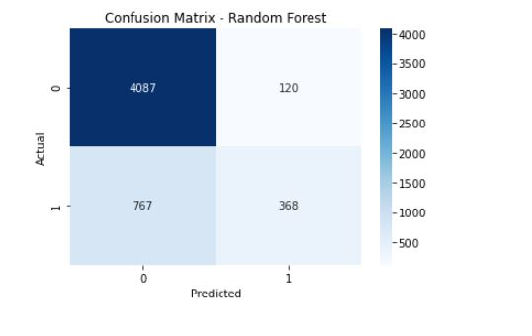
Confusion Matrix
A confusion Matrix gives us a clearer picture of the types of errors the model makes, beyond accuracy alone

Slide 12
Recommendation
1.Target groups with low vaccination likelihood. Use the model to identify individuals or population groups who are less likely to receive the H1N1 vaccine, and prioritise them for awareness campaigns and outreach programs.
2. Strengthen doctor recommendations. Since a doctor’s recommendation is likely a strong predictor of vaccine uptake, healthcare providers should be encouraged to recommend the H1N1 vaccine to eligible patients actively.
3. Use data-driven vaccination strategies. The predictive model can help public health planners allocate resources more effectively by identifying high-risk groups, hesitant groups and regions or demographics with lower expected uptake
4. Focus on recall when evaluating interventions. Because missing people who are unlikely to vaccinate can weaken intervention efforts, stakeholders should pay close attention to recall when choosing the best predictive model.

Slide 13
Conclusion
This project developed a machine learning model to predict whether an individual received the H1N1 vaccine using survey data from the National 2009 H1N1 Flu Survey. The model helps public health stakeholders identify the factors that influence vaccine uptake and predict which groups are less likely to vaccinate. These insights can support targeted awareness campaigns, healthcare planning, and better vaccine distribution strategies.

Slide 14
THANK YOU

